Slide 1
Audit Planning
Ludovicus Sensi Wondabio

Slide 2
Training Agenda
Audit cycle.
Main reasons of planning.
Pervasive activities of planning
SPAP
Audit planning activities.

Slide 3
“Why” of Preliminary Planning
What is the purpose of performing preliminary planning activities?
What types and sources of information can be used to gather information about the entity and/or industry under audit?
Why do we need to understand the entity’s business?
Why do we need to understand the accounting process?
Why do we need to obtain an understanding of the control environment?

Slide 4
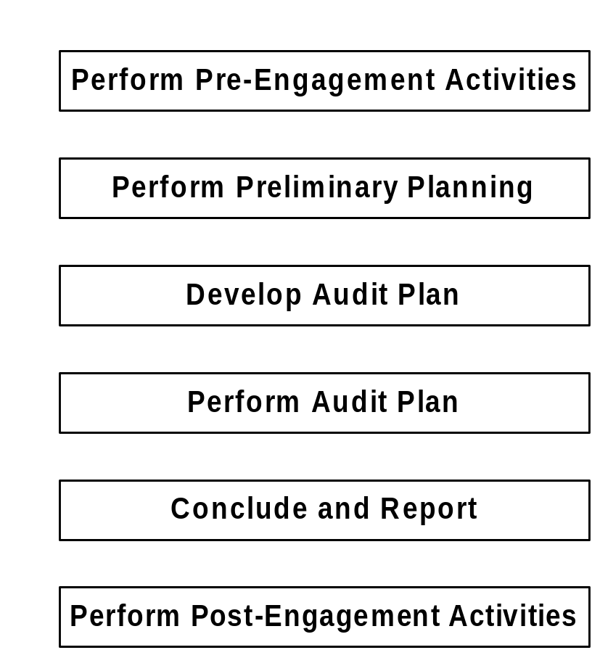
I. Audit Cycle

Slide 5
II. Main Reasons for Planning
1. To obtain sufficient competent evidence
for the circumstances
2. To help keep audit costs reasonable
3. To avoid misunderstanding with the client

Slide 6
III. Pervasive Activities
  Manage the audit engagement
  Assess and manage risk
  Implement the client service standards
  Prepare, review, and control working papers
Notes:
Objective 2.2 continued
Use the slide to review the pervasive activities included in the AuditSystem/2 audit approach.
Direct participants to look again inside the back cover of The Audit Approach manual and find the large fold out audit diagram. Note that these key attributes are reflected in the so-called pervasive activities depicted in the diagram as surrounding the approach.

Slide 7
III. Standar Profesional
Akuntan Publik
Standar Pekerjaan Lapangan No. 1:
Pekerjaan harus direncanakan sebaik-
baiknya dan jika digunakan asisten harus
disupervisi dengan semestinya.

Slide 8
IV. Audit Planning Activities
Perform Pre-Engagement Activities.
Perform Preliminary Planning Activities
  Understand the client’s business and industry.
  Understand accounting process.
  (include understand internal control and assess control risk).
  Perform preliminary analytical procedures.
  Set materiality
Develop overall audit plan.
(include assess acceptable audit risk and inherent risk)

Slide 9
1. Perform
Pre-Engagement Activities

Slide 10
Brainstorming Engagement Risk
  When do we consider our assessment of engagement risk?
  Why do we assess engagement risk?
  How do we use the knowledge gained when assessing the engagement risk?

Slide 11
AUDIT CASE
PT Ban Indonesia
General Audit
Period: 31 December 2005
Guide 1 : General Overview of Audit Case

Slide 12
1. Perform pre-engagement activities
Decides whether to accept a new client or continue – assess engagement risk.
  New client investigation.
  Continuing clients.
Why the client wants/needs an audit which will affect the remaining planning - Identify client’s reasons for audit.
  See P8 Client Acceptance Memo
Notes:
WP: Form survey, CAM/CCM, 1210, independensi checking

Slide 13
1. Perform pre-engagement activities (cont’d)
Prepared the terms of engagement.
Develop audit strategy
  Select staff for engagement.
  Evaluate need for outside specialist
Notes:
WP: Form survey, CAM/CCM, 1210, independensi checking

Slide 14
1.1 Engagement Risk
Definition
For an audit engagement, the risk that the:
  Firm may be exposed to adverse consequences as a result of its association with client
  Financial statements as a whole may be subject to material errors/misunderstanding by users as a result of factors that may be:
    Pervasive to the audit engagement and financial statements
    Specific to significant account balance(s) and related potential error(s)
Notes:
Objective 3.1 continued
Use the slide to provide a definition of engagement risk.
You might want to ask participants to provide a definition of engagement risk before showing the slide.
Ensure that participants understand the terms “pervasive to the audit engagement and financial statements” and “specific to a significant account balance and related potential error.”

Slide 15
Inherent Risks?
  The miscellaneous revenues balance increased materially. We did not identify any new or unusual sources of revenue. What specific risks could this situation indicate?
  The accounts receivable balance increased significantly, but sales did not increase at a corresponding rate. What specific risks could this situation indicate?
  The client’s physical limitations on inventory storage are inconsistent with the balance of inventory on hand. What specific risks could this situation indicate?
Notes:
Objective 3.6 continued
Use the slide to discuss each of the three questions listed.
The miscellaneous revenues balance increased materially. We did not identify any new or unusual sources of revenue. What specific risks could this situation indicate?
In this situation there were unusual changes in balances. In some situations these unusual changes are the absence of expected changes.
These changes could potentially be a misclassification that could mislead a financial statement user.
The accounts receivable balance increased significantly, but sales did not increase at a corresponding rate. What specific risks could this situation indicate?
This situation could indicate potential errors relating to validity, recording, or valuation of receivables.
In this case there were unusual changes in key financial relationships. It resulted in an unexpected increase in gross margins. This could indicate potential errors in sales, cost of sales, and/or inventories.
The client’s physical limitations on inventory storage are inconsistent with the balance of inventory on hand. What specific risks could this situation indicate?
In this case key financial/nonfinancial relationships are inconsistent. The client’s production capacity is inconsistent with recorded sales and changes in inventories. Potentially sales or inventory could be overstated and/or cost of sales may be understated.
When we evaluate the results of these procedures we should also consider our understanding of the business and our prior experience with the client.

Slide 16
Inherent Risks (cont’d)
Assess Risk at the Account Balance and Potential Error Level
  Analysis of the account balance
  Factors that may increase the risk of misstatement
  Fraud and error
Notes:
Objective 5.1: Assess risk at the account balance and potential error level.
Use the slide to discuss pinpointing specific risks.
The audit approach requires us, for significant account balances, to assess risk at the account balance and potential error level. To do this we:
Analyze the account balance (are there unusual or unexpected balances and relationships that may indicate a specific risk).
Consider factors, including risk or error, that may increase the risk of misstatement.
Direct participants to look inside the back cover of The Audit Approach manual and find the large fold out audit diagram. Focus their attention on the Assess Risk at the Account and Potential Error Level box within the Develop Audit Plan phase of the audit approach.
Ensure that they understand that this assessment results in either:
Specific Identified Risk, or
No Specific Identified Risk.

Slide 17
Inherent Risks (cont’d)
Factors that Increase the
Risk of Error
  Non-systematically processed transactions
  Unusual or complex transactions
  History of error
  Estimates and period-end adjustments
Notes:
Objective 5.1 continued.
Use the slide to further discuss pinpointing specific risks.
Past experience and the results of an international error study conducted by some of the large member firms, have shown that the above factors commonly increase the likelihood of misstatement at the account balance level.
Nonsystematically processed entries: Transactions that are few in number but relatively large in amount and therefore often material. For example, provision for loan losses, provisions for inventory obsolescence and cutoff that are not determined systematically by a reliable accounting system.
Unusual or complex transactions: For example, complex hedging transactions involving futures and options may indicate an increased risk in assessing the valuation of long-term liabilities.
History of error: For example, incorrect profit elimination of intercompany sales in the prior period may indicate an increased risk of misstatement of this same adjustment in the current period.
Estimates and period-end adjustments: Generally the evidence available to support an accounting estimate is not conclusive and the judgments involved are often subjective.
Transactions recording cutoffs and accruals, even if they are not based on estimates, may be specific risks because they are recorded infrequently and are often susceptible to manipulation by the client.

Slide 18
1.1 Engagement Risk -
Responses to Engagement risk
  Increased professional skepticism
  Involve a second partner or specialists
  Use more experienced staff
  Increase involvement of engagement management
  Restrict reliance on internal controls
  Refuse to accept tight deadlines
Appendix 1. Fraudulent Financial Reporting
Notes:
Objective 3.1 continued
Use the slide to discuss responses to engagement risk.
You may want to ask participants how we respond to engagement risk before displaying the slide.
Our assessment of engagement risk can only be made in the circumstances of the particular audit engagement, using professional judgment.
If we accept an audit engagement and engagement risk is assessed as greater than normal or much greater than normal or if new conditions come to light after appointment that cause us to believe that engagement risk is greater than normal or much greater than normal, we should respond appropriately in the planning and performing the audit engagement.
Emphasize the importance of an ongoing assessment of the appropriateness of our assessment of engagement risk, particularly as new information comes to our attention.

Slide 19
1.2 Terms of the Engagement
  Objective of the audit engagement
  Management’s responsibilities
  Scope of the audit engagement
  Inherent limitations of an audit
  Access to records
  Other auditors, specialists, and internal auditors
  Timing, fees, etc.
Notes:
Objective 3.1 continued
Use the slide to discuss the terms of the engagement.
In order to identify and resolve potential misunderstandings, we document the agreed terms of the audit engagement and communicate these to the client at the beginning of an audit engagement and as a minimum annually thereafter.
Emphasize that DTTI policies require us to do this annually.
An engagement letter is the preferred method for documenting terms of an engagement and it is desirable that an engagement letter be used on every audit engagement.
We should also establish at this stage what the client’s expectations are with respect to the service they are looking to us to provide. Some of these expectations may go beyond the scope of our audit engagement but we may agree to provide the necessary additional services in an engagement separate from the audit and for an appropriate fee.

Slide 20
1.3 Select the Engagement Team
Experience, industry knowledge, requirements specific to the audit engagement
Member Firm specialists
  Involve CAS specialists
  Consult with Firm specialists
Direct assistance from internal auditors
Notes:
Objective 3.1 continued
Use the slide to discuss selecting the engagement team.
Note the following with regard to selecting the engagement team:
The team may include more than the professional audit staff.
As field seniors, they will have to establish working relationships with the “whole team” and that this may involve coordinating work with other Deloitte & Touche departments or the client’s internal audit department.
The Client Service Partner should select an appropriate engagement team, based on experience, industry knowledge, and requirements specific to the audit engagement
When Firm specialists (e.g., computer audit specialists, actuaries, tax specialists) are consulted, the client service partner retains overall responsibility for the work performed and the conclusions reached.
In certain circumstances we may use internal auditors to provide direct assistance. In these circumstances, they perform certain work under our supervision and as part of the engagement team.
There are some restrictions on the work that they can perform for us (see Chapter 6 of The Audit Approach manual for additional guidance).
This is different from instances where we rely on internal auditors as part of the internal control structure or place reliance on work they have performed.

Slide 21
Where are the costs in an audit?
For an average job, what percentage of the total cost is incurred during each stage of the audit?
Preliminary Planning &
Development of Audit Plan 25%-35%
Performing the Audit Plan 45%-55%
Concluding & Reporting 15%-25%

Slide 22
Case Study
Read the following files:
Guide 2 Company Background
Guide 3 Unaudited FS 31 October 2005
P1 Client Communication Strategy
P2 Client Services
P3 Summary of Client Participation
P6 Minutes of Meeting on Management Assessment of Risk and Fraud
P7 Engagement Team Planning Discussion
P8 Client Acceptance Memo
P9 Engagement Budgeting
P10 Engagement Letter
P11 Planning Checklist
Notes:
Objective 3.1 continued
Use the slide to discuss selecting the engagement team.
Note the following with regard to selecting the engagement team:
The team may include more than the professional audit staff.
As field seniors, they will have to establish working relationships with the “whole team” and that this may involve coordinating work with other Deloitte & Touche departments or the client’s internal audit department.
The Client Service Partner should select an appropriate engagement team, based on experience, industry knowledge, and requirements specific to the audit engagement
When Firm specialists (e.g., computer audit specialists, actuaries, tax specialists) are consulted, the client service partner retains overall responsibility for the work performed and the conclusions reached.
In certain circumstances we may use internal auditors to provide direct assistance. In these circumstances, they perform certain work under our supervision and as part of the engagement team.
There are some restrictions on the work that they can perform for us (see Chapter 6 of The Audit Approach manual for additional guidance).
This is different from instances where we rely on internal auditors as part of the internal control structure or place reliance on work they have performed.

Slide 23
Case Study
Complete the related WP:
P4 Assess engagement risk and control environment
P5 Check List of Management on Fraud
Notes:
Objective 3.1 continued
Use the slide to discuss selecting the engagement team.
Note the following with regard to selecting the engagement team:
The team may include more than the professional audit staff.
As field seniors, they will have to establish working relationships with the “whole team” and that this may involve coordinating work with other Deloitte & Touche departments or the client’s internal audit department.
The Client Service Partner should select an appropriate engagement team, based on experience, industry knowledge, and requirements specific to the audit engagement
When Firm specialists (e.g., computer audit specialists, actuaries, tax specialists) are consulted, the client service partner retains overall responsibility for the work performed and the conclusions reached.
In certain circumstances we may use internal auditors to provide direct assistance. In these circumstances, they perform certain work under our supervision and as part of the engagement team.
There are some restrictions on the work that they can perform for us (see Chapter 6 of The Audit Approach manual for additional guidance).
This is different from instances where we rely on internal auditors as part of the internal control structure or place reliance on work they have performed.

Slide 24
2. Perform Preliminary Planning

Slide 25
2. Perform Preliminary Planning
  Understand the client’s business and industry.
  Understand accounting process.
    Understand internal control
    Assess control risk.
  Perform preliminary analytical procedures.
  Set materiality
  Assess acceptable audit risk and inherent risk.

Slide 26
2.1 Understand the client’s business and industry (cont’d)
Understanding approach:
Industry and external environment
Business operations and processes
See P12 Understanding the Entity and Its Environment

Slide 27
2.1.1 Industry and External Environment
Reasons for obtaining an understanding of the
client’s industry and external environment:
1. Risks associated with specific industries
2. Inherent risks common to all clients in
certain industries
Unique accounting requirements
Industry regulations

Slide 28
2.1.2 Client’ s Business
Factors the auditor should understand:
  Identify material classes of transactions
  Evaluate accounting policies
  Provide basis for risk assessment
  Identify management concerns
  Assist in developing effective & efficient audit plan
Notes:
Objective 3.2 continued
Use the slide to discuss why understanding the client’s business is important to us as auditors.
Our knowledge and understanding of the client’s business are the foundation for the development of an effective and efficient audit plan that responds to risks identified.
Understanding our client’s business also enables us to identify areas where we can provide meaningful business condition insights to management.
The experience of engagement management is a vital element of building this knowledge and understanding.
As participants progress through the Firm they, too, will have a significant contribution to make in this area.

Slide 29
2.1.2 Client’s Business (cont’d)
Factors the auditor should understand:
  Recognize organizational and other controlling structures
  Implement client service standards
  Major sources of revenue
  Key customers and suppliers
  Sources of financing
  Information about related parties
Notes:
Objective 3.2 continued
Use the slide to discuss why understanding the client’s business is important to us as auditors.
Our knowledge and understanding of the client’s business are the foundation for the development of an effective and efficient audit plan that responds to risks identified.
Understanding our client’s business also enables us to identify areas where we can provide meaningful business condition insights to management.
The experience of engagement management is a vital element of building this knowledge and understanding.
As participants progress through the Firm they, too, will have a significant contribution to make in this area.

Slide 30
2.1.2 Client’s Business (cont’d)
The Sources of Information
Discussions with management
  Planning meetings
  Client interviews
Visit principal locations
  Inventory counts
  Production facilities
Review internal reports and documents
  Board minutes
  Budgets
Review external reports and documents
  Industry journals
  Financial press
Notes:
Objective 3.2 continued
Use the slide to review the sources of information discussed in the audit manual.
Give examples of each category using local clients that participants will be aware of; use the above slide for assistance.
Other suggestions may include discussions with internal D&T staff (they will have obtained their information from one of the above methods initially).
Information in previous year’s files will also have been obtained in the same way. This does not mean we ignore information held in our files.
We will have a lot of information on our clients from previous years that is still valid and that we will mainly be updating our information and verifying it.
Many of the activities involved may be done by junior members of the audit team; consequently, it is everybody's responsibility to gather the information.
Use examples from your experience.
Encourage participants to begin to think in terms of ‘their’ client, and not just two or three week assignments; suggest, for example, that they should follow their client’s progress in the financial press.
Note that from a personal viewpoint, gaining a thorough understanding of your client’s business is likely to provide greater job satisfaction.

Slide 31
2.1.2 Client’s Business (cont’d)
The Sources of Information
Perform tour to the Plant and Offices
By viewing the physical facilities, the auditor can asses physical safeguards over assets and interpret accounting data related to assets.

Slide 32
2.2 Understand Accounting Process
  Understand Accounting Cycle activities:
  Classify client’s use of computers
  Prepare high-level overview of accounting process
  Understand computer environment
  Understand computer control structure
  See P13 Accounting Process and P14.xx Accounting Cycle Series.
Notes:
Objective 3.4 continued
Use the slide to review the main activities included in obtaining an understanding of the accounting process.
The first activity is the classification of the client’s use of computers.
The first two activities are required for all audit engagements.
Where the client’s use of computers is classified as minor, the last two are generally not necessary.

Slide 33
2.2 Understand Accounting Process –
Classification of Computer
Criteria:
  Extent of use
  Complexity
  Importance
Range:
  Limited - Moderate - Pervasive
  Simple - Moderate - Complex
  Limited - Moderate - Very Important
See P13.1 Client Use of Computer
P13.1.1 Understanding Computer Environment
Notes:
Objective 3.5 continued
Use the slide to discuss classification criteria.
To classify the client’s use of computers, we consider:
Extent to which the client uses computers in the business.
Complexity of the computer environment.
Importance of computer systems to the client’s business activities.
Direct participants to open their The Audit Approach: Detailed Guidance manuals to Paragraphs 8.23.01 to 8.23.09 which discusses each of the above criteria.
Spend 5 minutes reviewing this guidance with the participants.

Slide 34
2.2 Understand Accounting Process –
Consequences of Classification
The classification of:
  Dominant
  Significant
  Minor
Has an impact on the need to:
  Use a specialist
  Adopt a control reliance strategy
  Understand the computer control structure
  Identify and test general computer controls
Notes:
Objective 3.5 continued
Use the slide to discuss the consequences of classification
For clients that are classified as computer-dominant or computer-significant:
We should gain an understanding of computer-based accounting systems, the computer environment, and the structure of computer controls.
For clients classified as computer-minor:
We should gain an understanding of the accounting systems, including manual systems, but we need not be concerned with understanding the computer environment or computer control structure.
For computer-dominant clients:
We should involve a CAS specialist in appropriate aspects of understanding the accounting process, establishing a rotation plan, and testing controls.
For computer-significant clients:
We also need to consider involving a CAS specialist or other individuals with similar skills in these areas, particularly if one or more systems or the computer environment is complex.

Slide 35
2.2.1 Understand internal control and assess control risk
- Internal Control Components.
Control environment
Risk assessment
Control activities
Information and communications
Monitoring
See P15 Top Level Control

Slide 36
2.2.1 Internal Control Components (cont’d)
Control Environment
Risk
Assessment
Control
Activities
Information and
Communication
Monitoring

Slide 37
2.2.1.1 Control Environment
Actions, policies and procedures that reflect the overall attitude of top management, directors and owners of the entity about internal control and its importance.
(Management control process)

Slide 38
2.2.1.1 Control Environment (cont’d)
Subcomponents:
  Integrity and ethical value
  Commitments to competence
  BOD and audit committee participation
  Management's philosophy and operating style
  Organizational structure
  Human resource policies and procedures

Slide 39
2.2.1.2 Risk Assessment
Management's identifications and analysis of risk relevant to the preparation of FS in accordance with GAAP

Slide 40
2.2.1.3 Control Activities
Policies and procedures that management has established to meet its objectives for financial reporting

Slide 41
2.2.1.3 Control Activities (cont’d)
Type of specific control activities:
  Adequate separations of duties
  Proper authorization of transactions and activities
  Adequate documents and records
  Physical control over assets and records
  Independent checks on performance

Slide 42
2.2.1.4 Information and Communication
Transaction-related audit objectives that must be satisfied (potential errors):
  Completeness
  Validity
  Recording
  Cut-off
  Valuation
  Presentation

Slide 43
2.2.1.5 Monitoring Activities
Management's ongoing and periodic assessment of the quality of IC performance to determine whether controls are operating as intended and are modified when needed

Slide 44
TOC Steps
Obtain and Document Understanding of Internal Control
Assess Control risk
Design, Perform and Evaluate
Decide Planned Detection Risk and Substantive Tests
Communicate to those charged with governance
  SPAP: PSA No. 35
Notes:
Contoh WP 1500an

Slide 45
Top-Down Approach
Number of Control Objectives Addressed
Senior Management
High-Level
Middle Management
Controls
Clerical Level
Detailed Controls

Slide 46
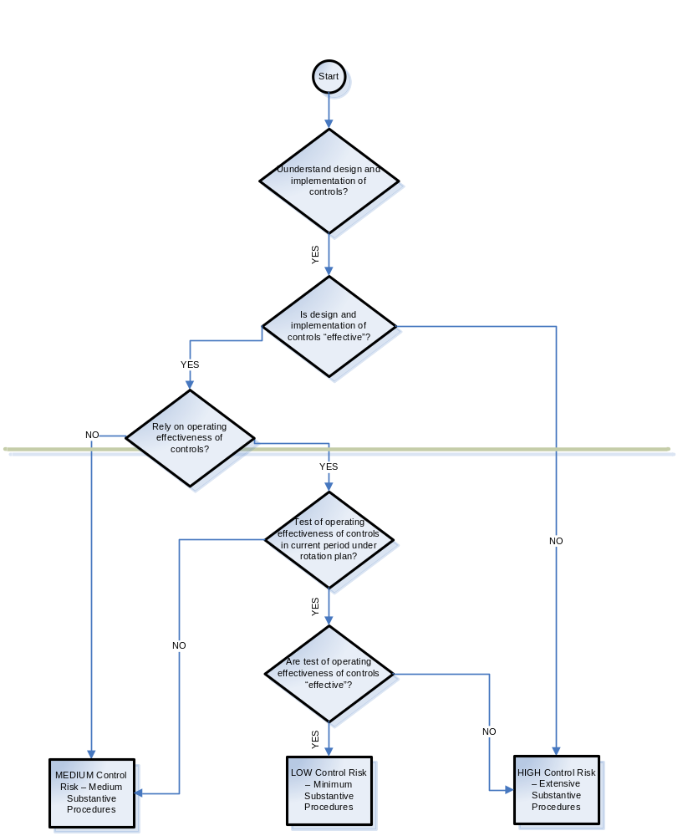
See Appendix 2
Notes:
Print 1 halaman sbg Lampiran 1

Slide 47
Business Cycles
Expenditure
Fixed Assets
Inventory
Payroll
Revenue
Treasury
See P14.xxx. Bussiness Cycle series

Slide 48
2.3 Preliminary Analytical Review
  Steps
  Obtain financial and non financial information
  Compare the information
  Analyze the information
Notes:
Objective 3.6 continued
Use the slide to discuss the steps in preliminary analytical review.
Preliminary analytical procedures are usually focused on account balances.
We are not seeking to obtain substantive assurance from a review of this nature.
The purpose is to obtain information and these procedures are therefore not performed with the same degree of rigor as a substantive analytical procedure.
Our analysis of the results of procedures may therefore be relatively high level.
We may consider examining documentation to support management’s explanations but only if we believe this to be necessary.

Slide 49
2.3 Preliminary Analytical Review
Sources of Information
  Client interim financial information
  General ledger
  Management accounts
  Budgets
  Discussions with management
  Prior year financial information
Notes:
Objective 3.6 continued
Use the slide to discuss the steps in preliminary analytical review.
NOTE: This slide builds, i.e., each time you advance an additional bullet point appears.
The usual approach is to compare the current year interim financial information with the prior year financial information and/or current year budgets. Our objective is to identify conditions that may indicate the risk of misstatement.
We consider both unusual changes, or the absence of expected changes in balances and key financial relationships.
It is often easier to identify unusual or unexpected changes in account balances by an analysis of trends and ratios.
Determining which comparisons and measures to perform is a matter of professional judgment.
If we find an unusual or unexpected balance or relationship we discuss the situation with the client.
Any explanations we receive must be consistent with our understanding of the client’s business. In some cases, we may need to examine documentary evidence.
In some cases unexplained balances or relationships are specific risks of misstatement.

Slide 50
2.3 Preliminary Analytical Review -
Five Types of Analytical Procedures
Compare client data with:
1. Industry data
2. Similar prior-period data
3. Client-determined expected results
4. Auditor-determined expected results
5. Expected results using nonfinancial data.

Slide 51
2.3 Preliminary Analytical Review -
Common Financial Ratios
Short-term debt-paying ability
Liquidity activity ratios
Ability to meet long-term debt obligations
Profitability ratios

Slide 52
Case Study
Read the following files:
Guide 4 Preliminary Analytical Inquiry
Complete the related WP:
P16 Preliminary Analytical
Notes:
Objective 3.1 continued
Use the slide to discuss selecting the engagement team.
Note the following with regard to selecting the engagement team:
The team may include more than the professional audit staff.
As field seniors, they will have to establish working relationships with the “whole team” and that this may involve coordinating work with other Deloitte & Touche departments or the client’s internal audit department.
The Client Service Partner should select an appropriate engagement team, based on experience, industry knowledge, and requirements specific to the audit engagement
When Firm specialists (e.g., computer audit specialists, actuaries, tax specialists) are consulted, the client service partner retains overall responsibility for the work performed and the conclusions reached.
In certain circumstances we may use internal auditors to provide direct assistance. In these circumstances, they perform certain work under our supervision and as part of the engagement team.
There are some restrictions on the work that they can perform for us (see Chapter 6 of The Audit Approach manual for additional guidance).
This is different from instances where we rely on internal auditors as part of the internal control structure or place reliance on work they have performed.

Slide 53
2.4 Materiality
2nd paragraph opinion :
Kami melaksanakan audit berdasarkan standar auditing yang ditetapkan Institut Akuntan Publik Indonesia. Standar tersebut mengharuskan kami merencanakan dan melaksanakan audit agar kami memperoleh keyakinan memadai bahwa laporan keuangan bebas dari salah saji material.

Slide 54
2.4 Materiality (cont’d)
PSA No. 25 of SPAP par. 10:
… Materialitas adalah besarnya informasi akuntansi yang apabila terjadi penghilangan atau salah saji, dilihat dari keadaan yang melingkupinya, mungkin dapat mengubah atau mempengaruhi pertimbangan orang yang meletakkan kepercayaan atas informasi tersebut. Definisi tersebut mengakui pertimbangan materialitas dilakukan dengan memperhitungkan keadaan yang melingkupi dan perlu melibatkan baik pertimbangan kuantitatif maupun kualitatif.

Slide 55
2.4 Materiality (cont’d)
ISA 25, “Audit Materiality,” par. 3
Information is material if its omission or misstatement could influence the economic decisions of users taken on the basis of the financial statements. Materiality depends on the size of the item or error judged in the particular circumstances of its omission or misstatement. Thus materiality provides a threshold or cut-off point rather than being a primary qualitative characteristic which information must have if it is to be useful.

Slide 56
2.4 Materiality Purpose
  Estimate tolerable level of misstatement
  Establish scope
  Evaluate effect of known and likely misstatements
Notes:
Objective 3.7 continued
Use the slide to continue your discussion of planning materiality.
The audit approach requires us to determine the amount of misstatement judged to be material in the financial statements. We call this amount the “planning materiality” for the engagement.
For audit purposes, we determine planning materiality in order to:
Estimate the tolerable level of misstatement in the financial statements.
Assist in establishing the scope of the audit engagement.
Assist in evaluating the effect of known and likely misstatements on the financial statements.
We perform auditing procedures to the extent necessary to obtain reasonable assurance that we will discover material misstatements in the financial statements, if they exist.
By the end of the audit engagement, we should have obtained sufficient audit evidence to support a conclusion that a material misstatement is unlikely to exist.
We may discover both known and likely misstatements during the audit engagement. We consider planning materiality to determine the effect on the financial statements of both known and likely misstatements that are not corrected by the client.
We are concerned not only with single misstatements that are material, but also with an accumulation of smaller misstatements that, when considered together, have a material effect on the financial statements.
The concept of materiality applies not only to monetary misstatements, but also to disclosure requirements and adherence to appropriate accounting principles and statutory requirements.

Slide 57
2.4 Materiality (cont’d)
The auditor’s responsibility is to determine
whether financial statements are
materially misstated.
If there is a material misstatement,
the auditor will bring it to the client’s
attention so that a correction can be made.

Slide 58
2.4 Materiality (cont’d)
  Public entities
  Nonpublic entities
  Wholly-owned subsidiaries
Notes:
Objective 3.7 continued
Use the slide to discuss materiality guidelines.
The auditor’s consideration of materiality is a matter of professional judgment.
The Firm provides quantitative guidelines that may be applied in determining the selected planning materiality:
Public entities
Nonpublic entities
Wholly-owned subsidiaries
We will discuss each of these guidelines separately.
Emphasize to participants that they will be involved in performing the calculations of quantitative guidelines for planning materiality as well as determining a selected level of planning materiality.
It is however the partner who should make the final decision and approve the selected amount. This should be done before significant fieldwork begins in order to avoid time having been spent addressing over or underauditing at a later stage in the audit.

Slide 59
Case Study
Read the following files:
Guide 5 Materiality, and choose the critical points.
Complete the related WP:
P17 Materiality calculations
Notes:
Objective 3.1 continued
Use the slide to discuss selecting the engagement team.
Note the following with regard to selecting the engagement team:
The team may include more than the professional audit staff.
As field seniors, they will have to establish working relationships with the “whole team” and that this may involve coordinating work with other Deloitte & Touche departments or the client’s internal audit department.
The Client Service Partner should select an appropriate engagement team, based on experience, industry knowledge, and requirements specific to the audit engagement
When Firm specialists (e.g., computer audit specialists, actuaries, tax specialists) are consulted, the client service partner retains overall responsibility for the work performed and the conclusions reached.
In certain circumstances we may use internal auditors to provide direct assistance. In these circumstances, they perform certain work under our supervision and as part of the engagement team.
There are some restrictions on the work that they can perform for us (see Chapter 6 of The Audit Approach manual for additional guidance).
This is different from instances where we rely on internal auditors as part of the internal control structure or place reliance on work they have performed.

Slide 60
3. Develop Overall
Audit Plan

Slide 61
3. Developing the Audit Plan Activities
  Assess risk at the account balance level
  Design of testing controls
  Describe the levels of substantive assurance within the audit assurance model
  See P18 Audit Planning Memorandum
Notes:
Session 5.5 continued.
Use this slide to recap the key learning points of this session.
Key points made during this session include:
The starting point for developing the audit plan is the pinpointing of risk at potential error level.
We can gain assurance as to the accuracy of a balance from three sources, inherent assurance, control assurance, substantive assurance. The level of assurance that we require from each source is dependent on whether we have identified a specific risk.
The Firm’s preferred audit strategy is to evaluate and test controls wherever possible.
Our approach to controls testing is “Top-Down” and is designed to help us identify monitoring activities and controls procedures that exist at the higher levels of management.
Ask participants if they have any questions or concerns regarding the material covered in this session.

Slide 62
3.1 Assessing Acceptable Audit Risk and Inherent Risk
Auditors accept some level of risk
in performing the audit.
An effective auditor recognizes that
risks exist, are difficult to measure,
and require careful thought to respond.
Responding to risks properly is critical
to achieving a high-quality audit.

Slide 63
3.1 Assessing Acceptable Audit Risk and Inherent Risk (cont’d)
Risk and Evidence
Auditors gain an understanding of the
client’s business and industry and
assess client business risk.
Auditors use the audit risk model to further
identify the potential for misstatements
and where they are most likely to occur.

Slide 64
3.1 Assessing Acceptable Audit Risk and Inherent Risk (cont’d)
Impact of Engagement Risk on Acceptable Audit Risk
Auditors decide engagement risk and use
that risk to modify acceptable audit risk.
Engagement risk closely relates to client
business risk.

Slide 65
3.1 Assessing Acceptable Audit Risk and Inherent Risk (cont’d)
Factors Affecting Acceptable Audit Risk
The degree to which external users
rely on the statements
The likelihood that a client will have
financial difficulties after the
audit report is issued
The auditor’s evaluation of
management’s integrity

Slide 66
3.1 Assessing Acceptable Audit Risk and Inherent Risk (cont’d)
Methods to Assess Acceptable Audit Risk
Factors
Methods Used
External users’
reliance on
financial
statements
Examine financial statements
Read minutes of the board
Discuss financing plans
with management

Slide 67
3.1 Assessing Acceptable Audit Risk and Inherent Risk (cont’d)
Methods to Assess Acceptable Audit Risk
Factors
Methods Used
Likelihood
of financial
difficulties
Analyze financial statements
for difficulties using ratios
Examine inflows and outflows
of cash flow statements
Management
integrity
Client acceptance and
continuance procedures

Slide 68
3.1 Assessing Acceptable Audit Risk and Inherent Risk (cont’d)
Factors Affecting Inherent Risk
Nature of the client’s business
Results of previous audits
Initial versus repeat engagement
Related parties
Nonroutine transactions
Judgment required to correctly record
account balances and transactions
Makeup of the population
Factors related to fraudulent financial reporting
Factors related to misappropriation of assets

Slide 69
3.1 Assessing Acceptable Audit Risk and Inherent Risk (cont’d)
The audit respond to risk:
Auditors can change the audit
to respond to risks
The engagement may require
more experienced staff
The engagement will be reviewed
more carefully than usual

Slide 70
3.1 Assessing Acceptable Audit Risk and Inherent Risk (cont’d)
Tolerable Misstatement, Risks,
and Balance-related Audit Objectives:
It is common to assess inherent and control
risk for each balance-related audit objective
It is not common to allocate materiality
to objectives

Slide 71
Audit Evidence
Substantive
Assurance
Analytical Procedures
and Tests of
Details
Tests of
Controls
Risk Assessment at
the Account Balance
and Potential Error
Level
Control
Assurance
Inherent
Assurance
Notes:
Objective 5.2 continued.
Use the slide to further discuss the Audit Assurance Model.
We obtain audit assurance for each significant account balance from one or a combination of the following three sources:
Inherent assurance: We obtain inherent assurance from assessing risk at the account balance and potential error level. We obtain a maximum level of inherent assurance when we have not identified a specific risk, and no inherent assurance when we have identified a risk.
Control assurance: We obtain control assurance from identifying and testing controls that prevent or detect the potential error.
Substantive assurance: We obtain substantive assurance from performing substantive analytical procedures, tests of details, or a combination of the two. Our substantive procedures should be designed to detect the potential error if it has occurred and was not detected by the client’s controls. For each potential error, substantive assurance should constitute some portion of our audit assurance.
We combine the different types of assurance, as set out in the audit assurance model in statistical terms, so as to achieve a 95% level of overall assurance.
Ask participants how much assurance we seek in statistical terms?
In statistical terms we seek a level of 95% overall assurance. This equates to a 5% overall risk which is considered acceptable by the Firm.

Slide 72
Audit Test Matrix — Potential Errors Tested Directly
Debits
  Validity
  Over recording
  Late cutoff
Credits
  Completeness
  Under recording
  Early Cutoff
Notes:
Objective 5.2 continued.
Use the slide to relate the audit test matrix to potential errors.
We apply the test matrix to potential errors tested directly in this manner as follows:
Validity of debits: Recorded debits should represent transactions that actually occurred or assets that exist.
Recording (overrecording) of debits: Debits should be recorded and summarized in amounts not in excess of the appropriate amounts.
Cutoff (late cutoff) of debits: Recorded debits should represent transactions that occurred in the current period and not in the subsequent period.
Completeness of credits: All valid transactions that actually occurred should be recorded.
Recording (underrecording) of credits: Credits should be recorded and summarized in amounts not less than the appropriate amounts.
Cutoff (early cutoff) of credits: All transactions that occurred in the current period should be recorded in the current period and not in the subsequent period.
Tests of potential errors involving valuation and presentation are performed in both directions for all account balances to which these potential errors relate.
By applying audit procedures to the potential errors listed on the transparency above, we eliminate the need to test directly the validity, overrecording or late cutoff of credits and the completeness, underrecording, or early cutoff of debits.

Slide 73
Impact of Information Technology on Audit Testing
Computer assisted audit techniques may be
used to test automated controls or data.
Reports produced by IT may be used to test
the effectiveness of IT general controls.
Program change controls
Access controls

Slide 74
Methodology for Designing Controls and Substantive Tests
Understand internal
control
Assess
control
risk
Determine
extent
of testing
controls
Design tests of controls
and substantive tests
of transactions to meet
transaction-related
audit objectives
Audit procedures
Sample size
Items to select
Timing

Slide 75
3.3 Assessing Acceptable Audit Risk and Inherent Risk (cont’d)
Audit Risk Model for Planning
AR = DR x IR × CR
where:
AR = Audit risk
DR = Detection risk
IR = Inherent risk
CR = Control risk

Slide 76
3.3 Assessing Acceptable Audit Risk and Inherent Risk (cont’d)
Reliability Factors
LOA | 50% | 55% | 60% | 65% | 70% | 75% | 80% | 85% | 90% | 95% | 98% | 99%
CF | 0,7 | 0,8 | 0,9 | 1,1 | 1,2 | 1,4 | 1,6 | 1,9 | 2,3 | 3,0 | 3,7 | 4,6
Note:
LOA = Level of Assurance
CF = Confidence Factor
Appendix 5 Relaibility Factors

Slide 77
3.3 Assessing Acceptable Audit Risk and Inherent Risk (cont’d) -
Audit Risk Model for Planning
  IR = Not Ok; CR = Not Ok; AR = 5%
  DR = 0,05/(1 x 1) = 0,05 ------------------ R = 3
  IR = Not Ok; CR = Ok (some); AR = 5%
  DR = 0,05/(1 x 0,45) = 0,05 -------------- R = 2,4

Slide 78
3.3 Assessing Acceptable Audit Risk and Inherent Risk (cont’d) -
Audit Risk Model for Planning
  IR = Ok; CR = Not Ok; AR = 5%
  DR = 0,05/(0,31 x 1) = 0,16 -------------- R = 1,8
  IR = Ok; CR = Ok; AR = 5%
  DR = 0,05/(0,31 x 0,31) = 0,5 ---------- R = 0,7

Slide 79
Audit Planning Memorandum —
Major Issues
  Key planning information and decisions
  Control reliance strategy
  Specific identified risks
  Business condition insights and client service objectives
  Determination of significant account balances
Notes:
Objective 5.5 continued.
Use the slide to review the audit planning memorandum.
The Audit Planning Memorandum:
Summaries of key planning information and decisions; including whether or not a control reliance strategy will be adopted for areas where no specific risk has been identified.
Summaries of all specific identified risks identified in the planning process and relevant account balances and potential errors and then planning an appropriate approach and audit procedures to reduce these risks to an acceptable level.
Summaries of the Business Condition Insights and Client Service Objectives that have been developed, but cannot be pinpointed to a specific account balance, together with planned audit procedures.
A determination of which account balances are considered significant and the subsequent activation of an additional assessment of risk at the account balance and potential error level.
Refer participants to the Audit Planning Memorandum (Form 1810) in their model audit files and discuss the key features of the document.

Slide 80
Key Learning

Slide 81
Phases of the Audit Process
Plan and design an audit approach.
Perform tests of controls.
Perform substantive testing.
Complete the audit and issue an
audit report.

Slide 82
Types of Tests
Risk assessment procedures
Tests of design and implementations
Test of controls
Analytical procedures

Slide 83
Types of Evidence
Documentation
Inquiries of the client
Analytical procedures
Observation
Reperformance
Recalculation
Physical examination

Slide 84
Questions?

Slide 85
Thank You

